Slide 1


DBT Introduce

Slide 2
Outline
DBT concepts
Demo-fact_inventory

Slide 3
What’s DBT(https://www.getdbt.com/
dbt is a transformation workflow that helps you get more work done while producing higher quality results.
You can use dbt to modularize and centralize your analytics code, while also providing your data team with guardrails typically found in software engineering workflows.
Collaborate on data models, version them, and test and document your queries before safely deploying them to production, with monitoring and visibility.
dbt compiles and runs your analytics code against your data platform, enabling you and your team to collaborate on a single source of truth for metrics, insights, and business definitions.
This single source of truth, combined with the ability to define tests for your data, reduces errors when logic changes, and alerts you when issues arise.

Slide 4
dbt optimizes your workflow
Avoid writing boilerplate DML and DDL by managing transactions, dropping tables, and managing schema changes. Write business logic with just a SQL select statement, or a Python DataFrame, that returns the dataset you need, and dbt takes care of materialization.
Build up reusable, or modular, data models that can be referenced in subsequent work instead of starting at the raw data with every analysis.
Dramatically reduce the time your queries take to run: Leverage metadata to find long-running models that you want to optimize and use incremental models which dbt makes easy to configure and use.
Write DRYer code by leveraging macros, hooks, and package management.

Slide 5
dbt provides more reliable analysis
No longer copy and paste SQL, which can lead to errors when logic changes. Instead, build reusable data models that get pulled into subsequent models and analysis. Change a model once and that change will propagate to all its dependencies.
Publish the canonical version of a particular data model, encapsulating all complex business logic. All analysis on top of this model will incorporate the same business logic without needing to reimplement it.
Use mature source control processes like branching, pull requests, and code reviews.
Write data quality tests quickly and easily on the underlying data. Many analytic errors are caused by edge cases in the data: testing helps analysts find and handle those edge cases.

Slide 6
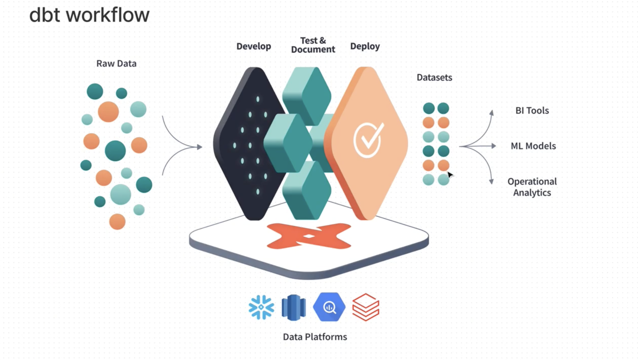
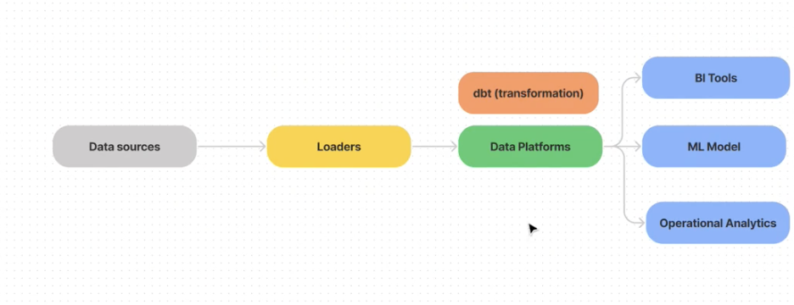
Dbt- A transform tool

Slide 7
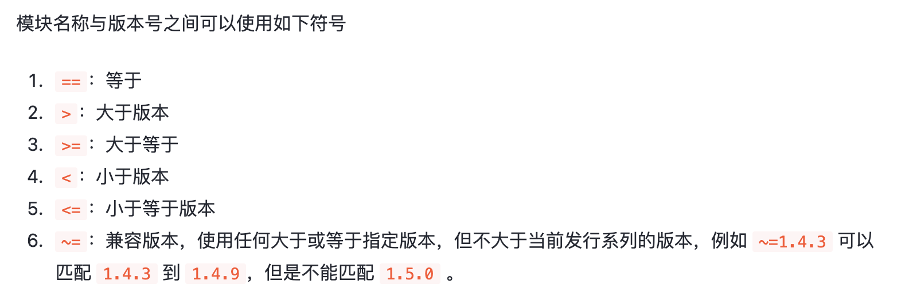
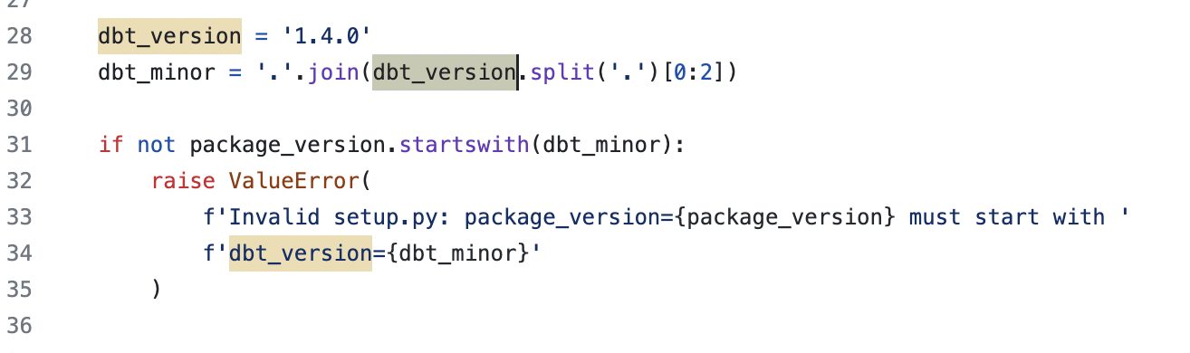
Dbt-Version(2023-09)
Dbt-cloud 1.7
Dbt core → cli 1.7
CH support to 1.4.7
Notes:
https://juejin.cn/post/7080328282113048583
https://github.com/ClickHouse/dbt-clickhouse/blob/main/setup.py

Slide 8
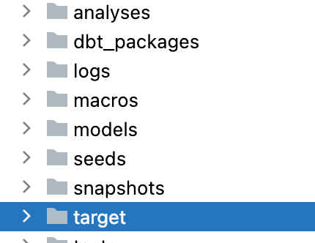
Concepts
Models
Source
Tests
Document
Materializations
Snapshot/seeds
Project.yml →
Hub(Ecosystem)
Notes:
https://datanav.juvoplus.com/test/dbt/#!/overview?g_v=1

Slide 9
DBT-models
Model: shaping of the data from raw data through to you final transformed data
Tables
source tables
intermediate tables/views
final tables
Models in dbt are SQL Select statements
Models live in the “models” directory
each model has a one-to-one relationship with a table or view in the data warehouse
Your config how dbt build your models and dbt will handle DDL/DML
Models are simply written as select statements - there is no DDL/DML that needs to be written around this. This allows the developer to focus on the logic.
Dbt run command. The default materialization is a view.
The materialization can be configured
ref macro(引用）→ build in macros
Notes:
https://docs.getdbt.com/reference/dbt-jinja-functions

Slide 10
DBT-Sources
Sources represent the raw data that is loaded into the data warehouse.
if location or naming of raw tables change you need to update across multiple files
Defined as yml file
Usage: source function:{{ source('stripe, 'payments’) }}
{{ source(‘ods’, ‘fb_daily_inventory’) }} compiles to ods.fb_daily_inventory
1. make updates in one place
2. visualize raw tables in your lineage
Notes:
https://courses.getdbt.com/courses/take/fundamentals/texts/27962334-review
https://docs.getdbt.com/reference/source-properties

Slide 11
DBT-commands-run
dbt run
dbt --debug run
dbt run –select your_model
dbt run –select +your_model
dbt run –select +your_model+
Notes:
https://docs.getdbt.com/reference/dbt-commands

Slide 12
Tests（not monitor)
Testing
Testing is used in software engineering to make sure that the code does what we expect it to.
In Analytics Engineering, testing allows us to make sure that the SQL transformations we write produce a model that meets our assertions.
In dbt, tests are written as select statements. These select statements are run against your materialized models to ensure they meet your assertions.
In dbt, there are two types of tests - generic tests and singular tests:
Generic tests are written in YAML and return the number of records that do not meet your assertions. These are run on specific columns in a model.
Singular tests are specific queries that you run against your models. These are run on the entire model.
dbt ships with four built in tests: unique, not null, accepted values, relationships.
Unique tests to see if every value in a column is unique
Not_null tests to see if every value in a column is not null
Accepted_values tests to make sure every value in a column is equal to a value in a provided list
Relationships tests to ensure that every value in a column exists in a column in another model
Notes:
https://courses.getdbt.com/courses/take/fundamentals/lessons/27962315-generic-tests

Slide 13
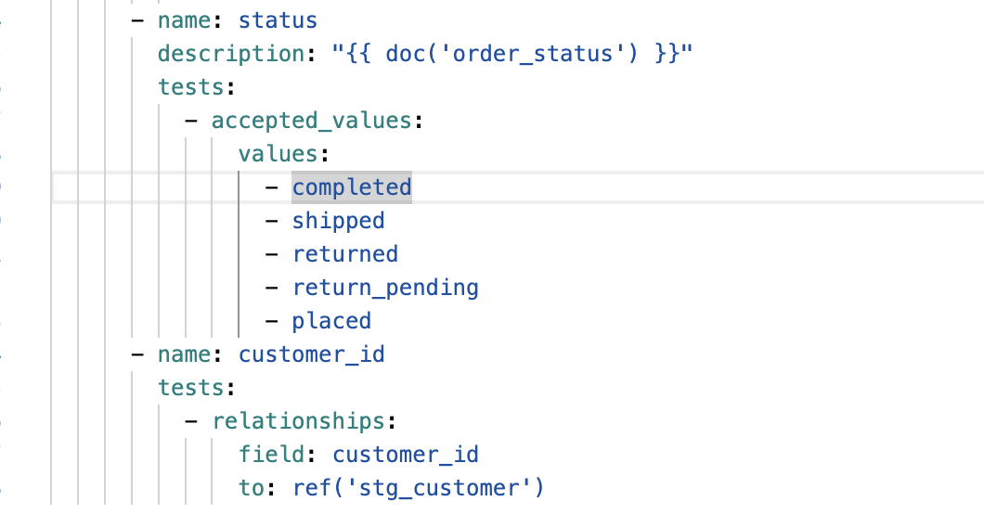
Tests-example

Slide 14
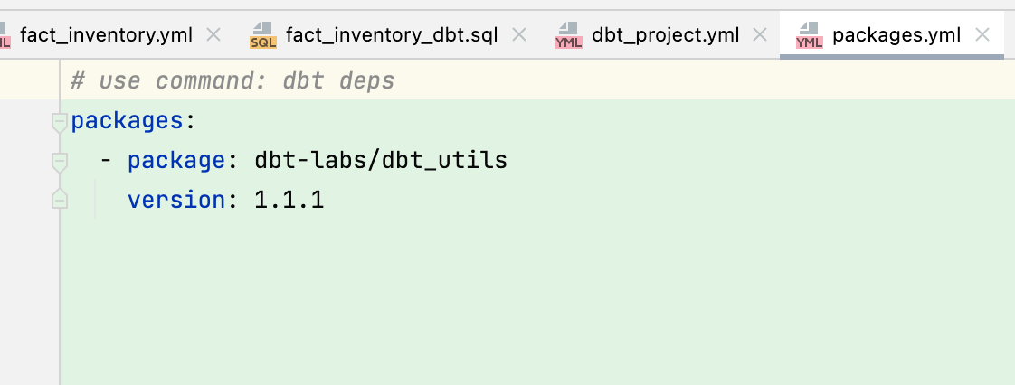
Tests-hub-生态
https://hub.getdbt.com/
https://hub.getdbt.com/dbt-labs/dbt_utils/latest/
dbt deps
Notes:
https://hub.getdbt.com/
Java: https://mvnrepository.com/artifact/com.clickhouse/clickhouse-jdbc/0.4.6

Slide 15
Document(1/3)
做完再写（没有了）！
修改忘记写（更新不及时），一句话，是分离的。往往运动式清理
Documentation is essential for an analytics team to work effectively and efficiently. Strong documentation empowers users to self-service questions about data and enables new team members to on-board quickly.
Documentation often lags behind the code it is meant to describe. This can happen because documentation is a separate process from the coding itself that lives in another tool.
Therefore, documentation should be as automated as possible and happen as close as possible to the coding.
In dbt, models are built in SQL files. These models are documented in YML files that live in the same folder as the models.

Slide 16
Document(2/3)
In the command line section, an updated version of documentation can be generated through the command dbt docs generate. The generated documentation includes the following:
Lineage Graph
Model, source, and column descriptions
Generic tests added to a column
The underlying SQL code for each model
and more...

Slide 17
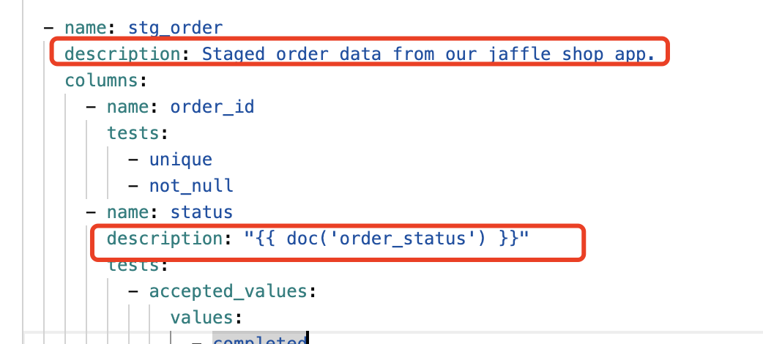
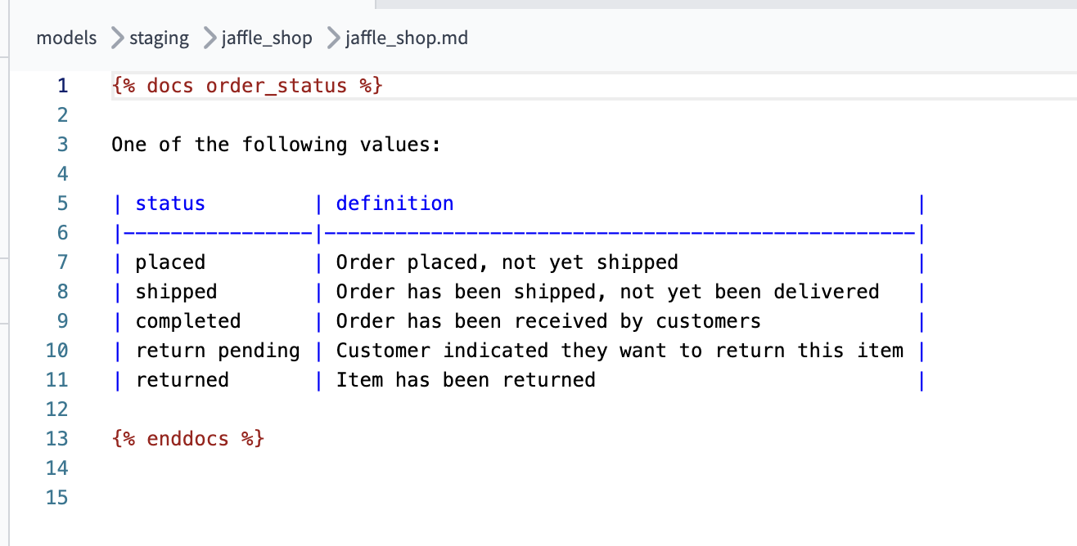
Document(3/3)
Writing documentation and doc blocks
Documentation of models occurs in the YML files (where generic tests also live) inside the models directory. It is helpful to store the YML file in the same subfolder as the models you are documenting.
For models, descriptions can happen at the model, source, or column level.
If a longer form, more styled version of text would provide a strong description, doc blocks can be used to render markdown in the generated documentation.

Slide 18
Materializations
Materializations are strategies for persisting dbt models in a warehouse. There are five types of materializations built into dbt. They are:
table
view
incremental
ephemeral
materialized view

Slide 19
Materializations-CH
Type | Supported? | Details
view materialization | YES | Creates a view.
table materialization (Partial) | YES | Creates a table. See below for the list of supported engines.
incremental materialization | YES | Creates a table if it doesn't exist, and then writes only updates to it.
ephemeral materialized | YES | Creates a ephemeral/CTE materialization. This does model is internal to dbt and does not create any database objects

Slide 20
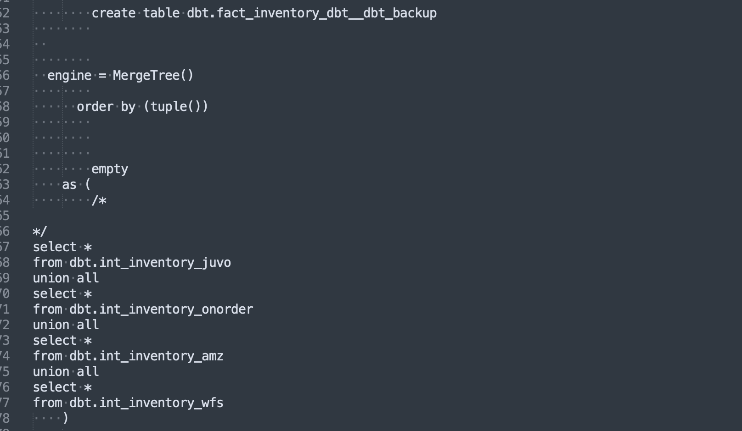
Materializations-CH

Slide 21
Materializations
Our data is not suitable for incremental

Slide 22
Tips
采用view/table的物化方式，实现1天数据的表
通过DML操作搬入到dws模型表中
参数传入方法

Slide 23
Snapshots(1/3)
Snapshots implement type-2 Slowly Changing Dimensions over mutable source tables(SCD2)
on the first run: dbt will create the initial snapshot table — this will be the result set of your select statement, with additional columns including dbt_valid_from and dbt_valid_to. All records will have a dbt_valid_to = null.
On subsequent runs: dbt will check which records have changed or if any new records have been created
Notes:
https://docs.getdbt.com/docs/build/snapshots

Slide 24
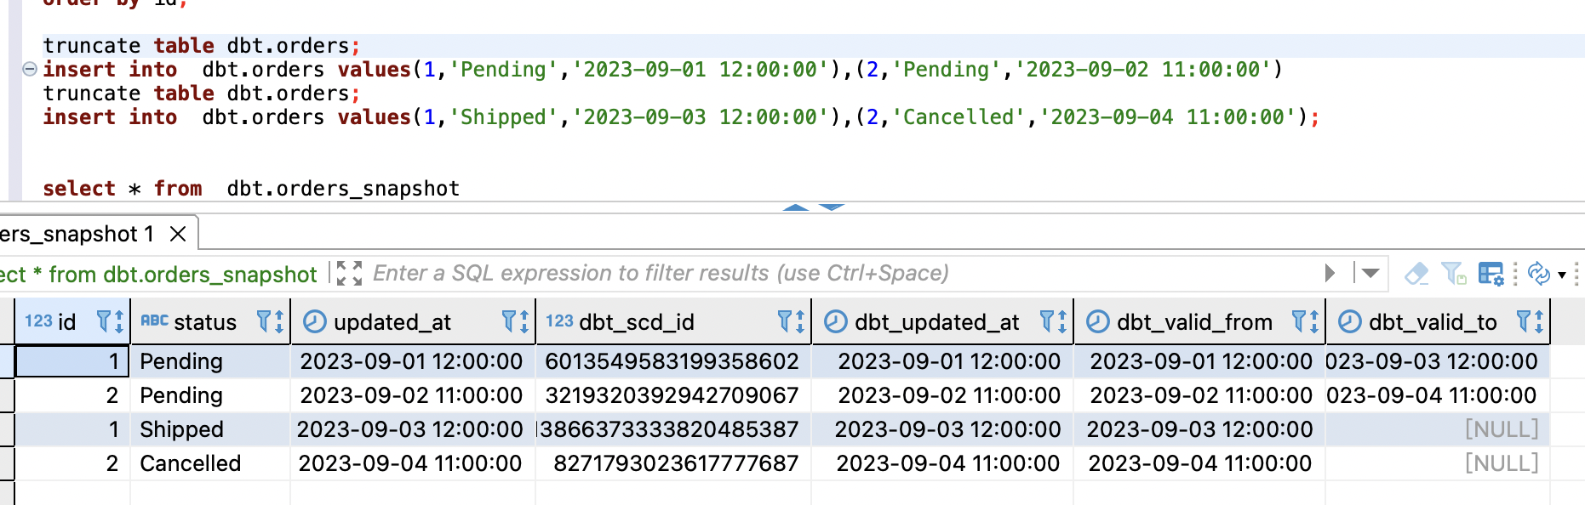
Snapshot(2/3)

Slide 25
Snapshots -- detail
insert into dbt.orders_snapshot ("id", "status", "updated_at", "dbt_scd_id", "dbt_updated_at", "dbt_valid_from", "dbt_valid_to")
select *,
halfMD5(coalesce(cast(id as varchar ), '')
|| '|' || coalesce(cast(updated_at as varchar ), '')
) as dbt_scd_id,
updated_at as dbt_updated_at,
updated_at as dbt_valid_from,
nullif(updated_at, updated_at) as dbt_valid_to
from (
select * from dbt.orders
) sbq
Notes:
insert into dbt.orders values(1,'Pending','2023-09-01 12:00:00'),(2,'Pending','2023-09-02 11:00:00')
insert into dbt.orders values(1,'Shipped','2023-09-03 12:00:00'),(2,'Cancelled','2023-09-04 11:00:00');

Slide 26
seeds
Seeds are .csv files that live in the seeds folder (or if you're using a dbt version prior to 1.0.0, it will be called the data folder) .
When executing dbt seed, seeds will be built in your Data Warehouse as tables. Seeds can be references using the ref macro - just like models!
✅ Seeds should be used for data that doesn't change frequently.
⛔️ Seeds should not be the process for uploading data that changes frequently
Seeds are useful for loading country codes, employee emails, or employee account IDs
Note: If you have a rapidly growing or large company, this may be better addressed through an orchestrated loading solution
https://www.mappr.co/political-maps/us-regions-map/
Notes:
https://docs.getdbt.com/reference/seed-properties

Slide 27
入门建议
使用dbt-cloud与snowflake(China’s sign up blocked)
https://cloud.getdbt.com/develop/189834/projects/277665
Resources:
https://docs.getdbt.com/quickstarts/snowflake
https://courses.getdbt.com/courses/fundamentals
https://courses.getdbt.com/courses/
Practices:
https://docs.getdbt.com/guides/best-practices

Slide 28
总结
Transform的流程非常清晰(可根据流程进一步优化代码）
文档与代码结合，代码即文档
Test-case集成run
规范性/运维性
灵活性（框住）
写（不方便）
迁移开始？

Slide 29
Checkout
Dev merge
Lifecycle
Always checkout a new feature branch from master
When dev finished, merge into Develop for UAT
UAT feedback changes have also been merged into the Develop branch.
When branch was published to PROD(Master), remove the branch
Develop
Master
uat-fix merge
prod merge
feature/inv
Feature/pnl
WK35
WK36
feature/so
fix/pnl
WK37
WK38
WK39
worker1: /home/ubuntu/uds2
worker1:/home/ubuntu/bill/pyproject/uds2_dev
Ch-dev: /home/ubuntu/uds2

